Slide 1
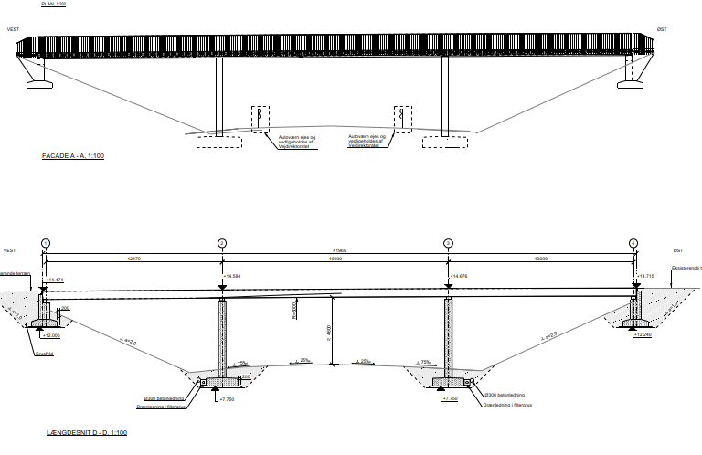
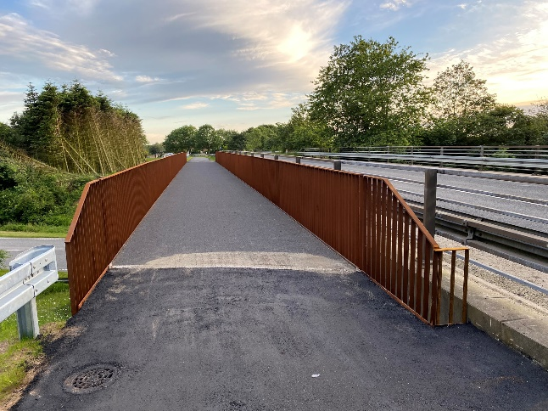
REFERENCE CONSTRUCTION WORKS
Bicycle and pederstrian bridge between St. Darum and Hovedvej 11, Bramming, Denmark
A new bicycle and pedestrian bridge is being constructed between St. Darum and Bramming, Denmark.
The project includes connecting the section with a bridge over Highway 11.
The bridge is made of Corten steel with a epoxy coating on the carriageway. The foundations, columns and abutments are constructed from concrete.
The work was carried out in 2023 and 2024.
Contract value:
DKK 5 Mio
Contractor:
Depenbrock Scandinavia ApS
Contract type:
Main Contract
Client:
Esbjerg Kommune
Construction period:
11.2023 – 04.2024
Location:
Bramming, Denmark
Technical specifications and quantities:
Corten steel 4x43 m, 40 ton.
Reinforced concrete: 36 m3
Road embankment: 2.150 m3
Relocation of various cables

